Slide 1
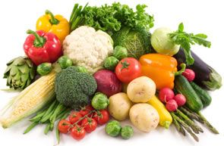



Vegetables
/v/
/e/
/g/
/t/
/i/
/b/
/l/
/z/

Slide 2
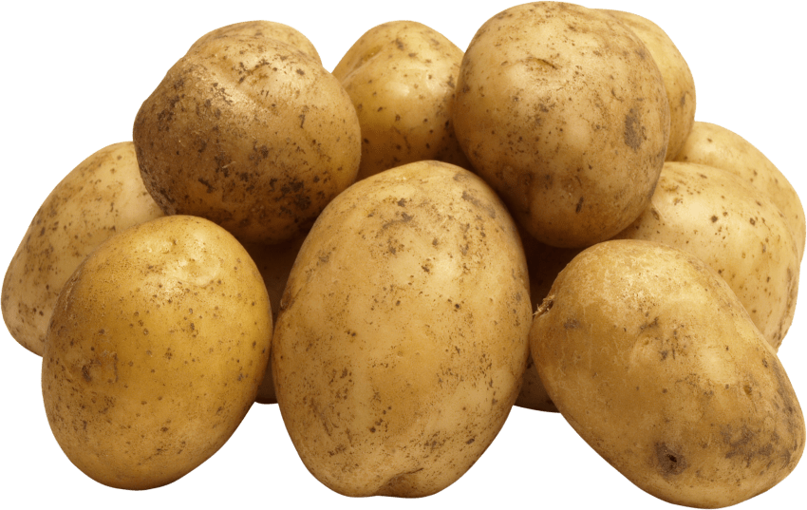
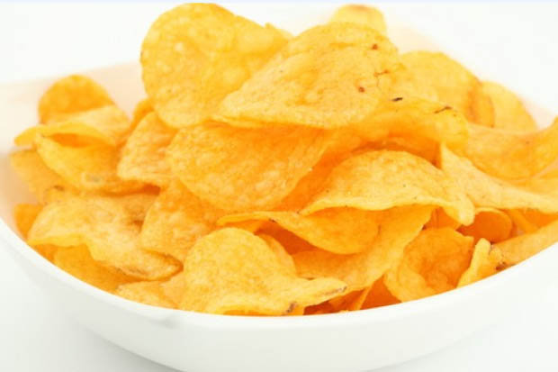
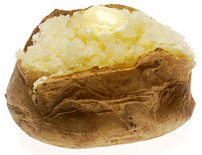
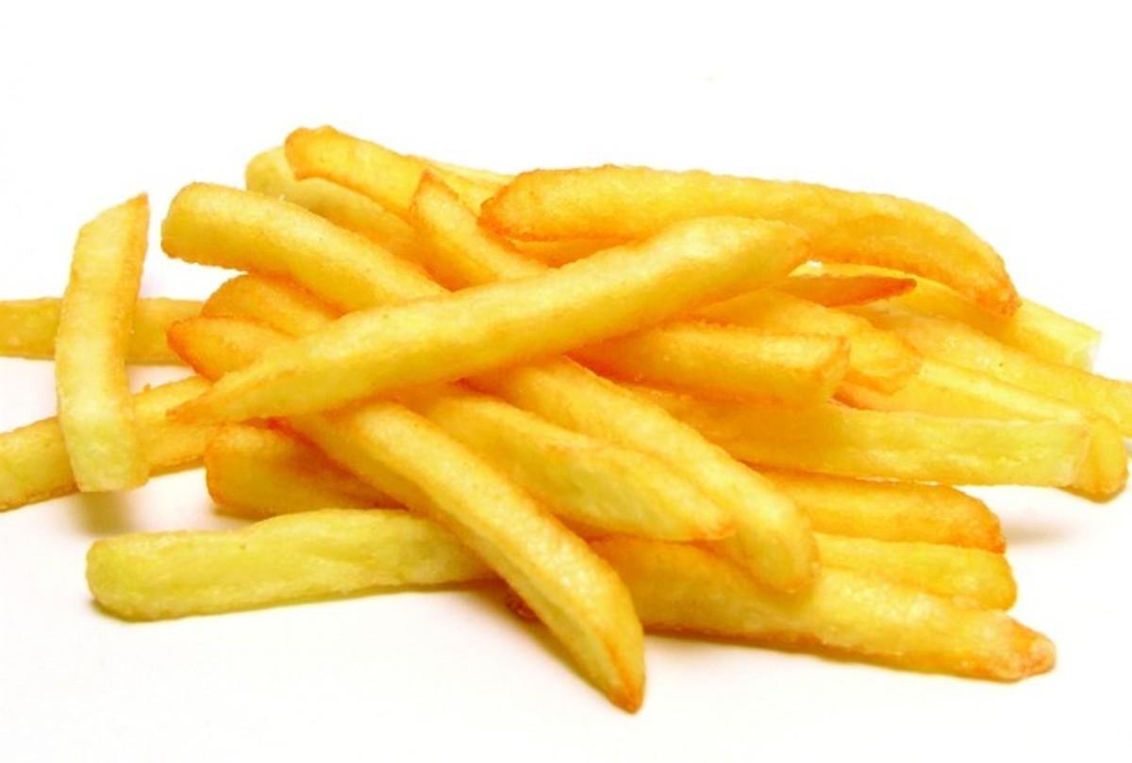
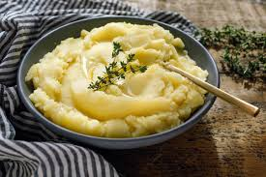
potato
/p/
/oa/
/t/
/ai/
/t/
/oa/
crisps
baked potato
chips
mashed potato

Slide 3
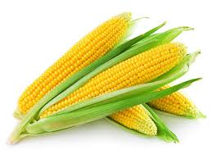
corn
/c/
/or/
/n/

Slide 4
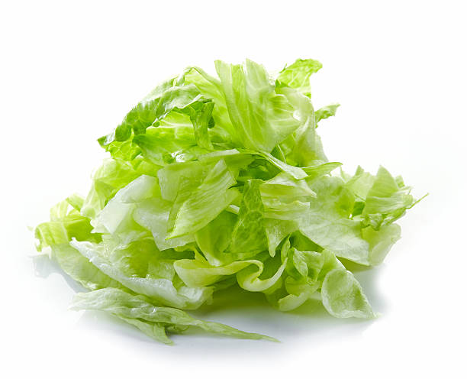
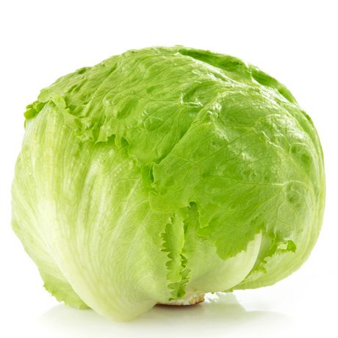
lettuce
/l/
/e/
/t/
/u/
/s/

Slide 5
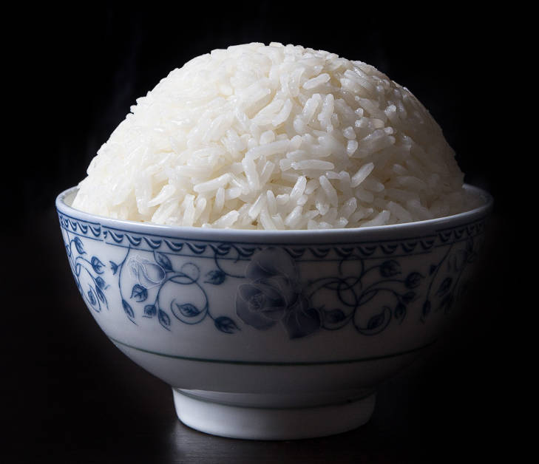
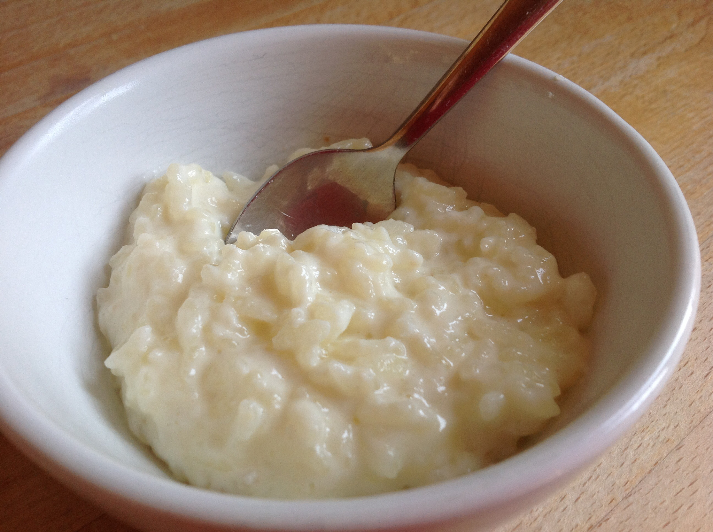
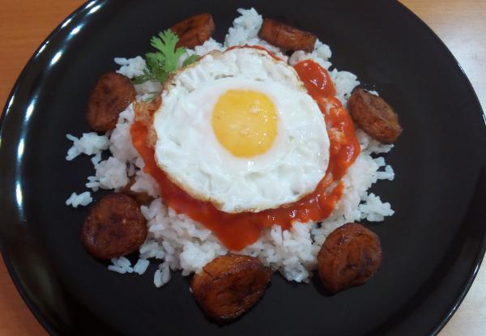
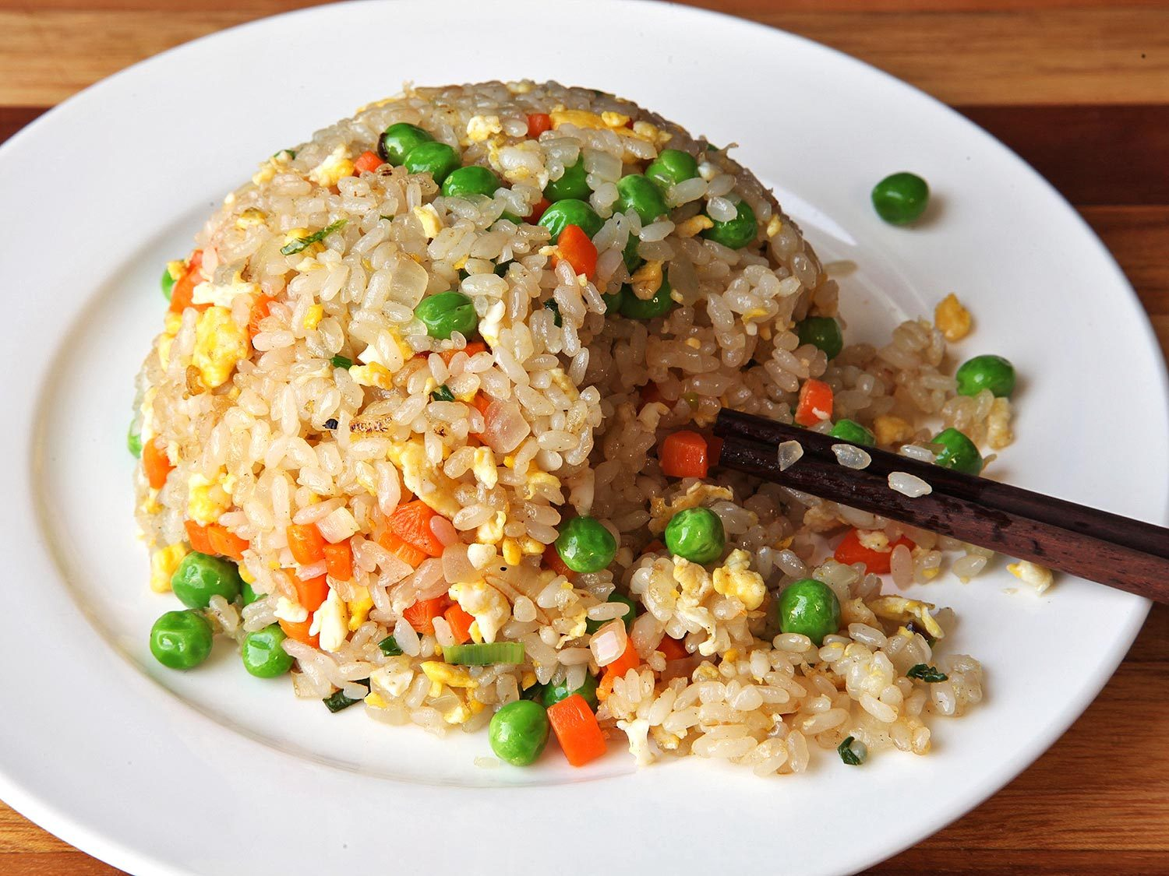
rice
/r/
/ie/
/s/

Slide 6
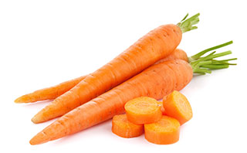
carrot
/c/
/a/
/r/
/o/
/t/

Slide 7
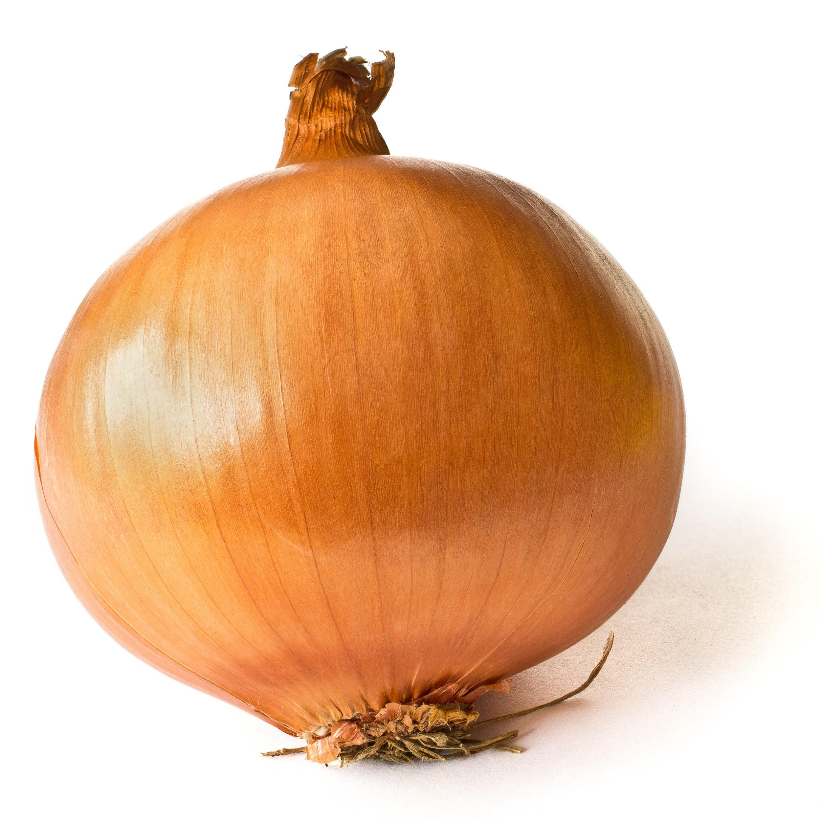
onion
/u/
/n/
/y/
/n/

Slide 8
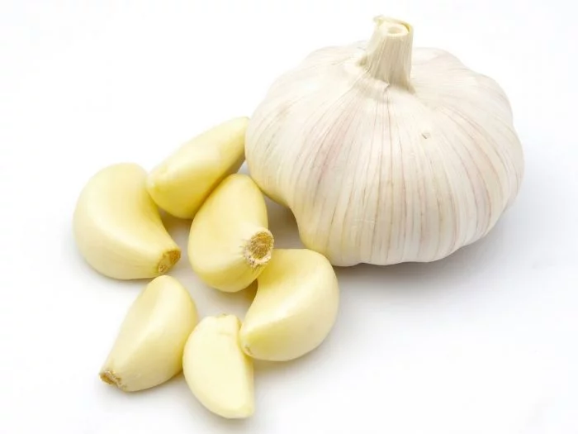
garlic
/g/
/ar/
/l/
/i/
/c/

Slide 9
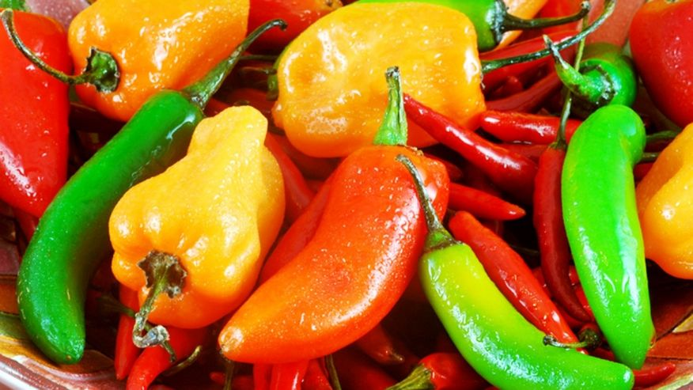
chilli
/ch/
/i/
/l/
/ee/

Slide 10
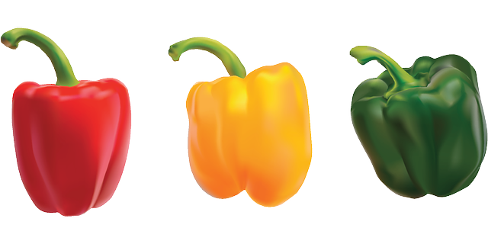
peppers
/p/
/e/
/p/
/er/
/z/

Slide 11
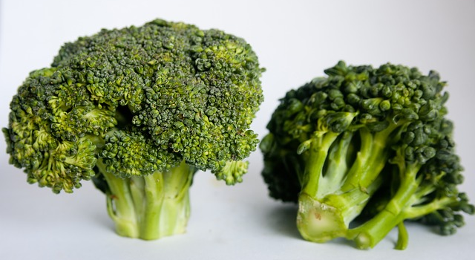
broccoli
/b/
/r/
/o/
/c/
/o/
/l/
/ee/

Slide 12
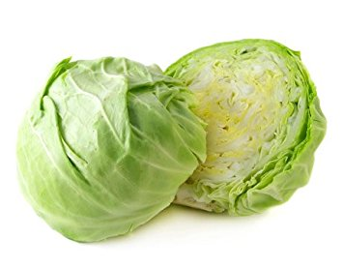
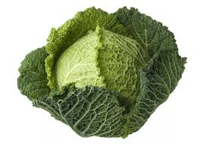
cabbage
/c/
/a/
/b/
/i/
/j/

Slide 13
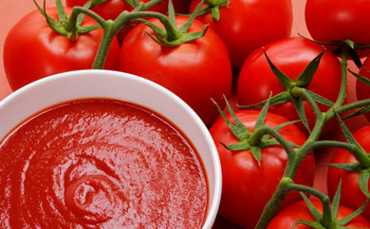
tomato
/t/
/o/
/m/
/a/
/t/
/oa/

Slide 14
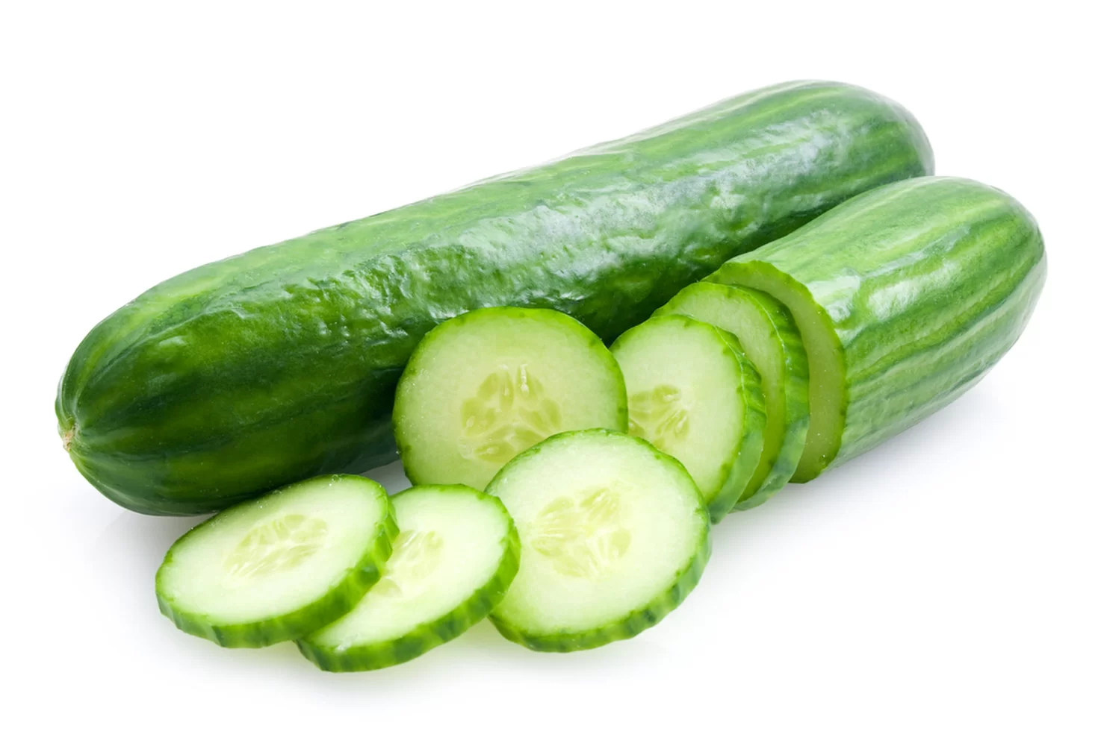
cucumber
/c/
/ue/
/c/
/u/
/m/
/b/
/er/

Slide 15
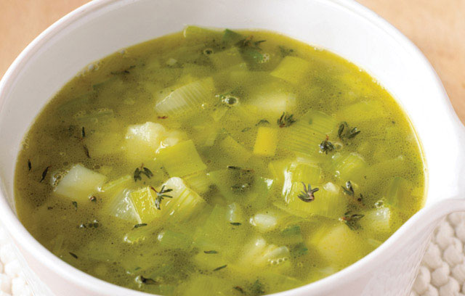
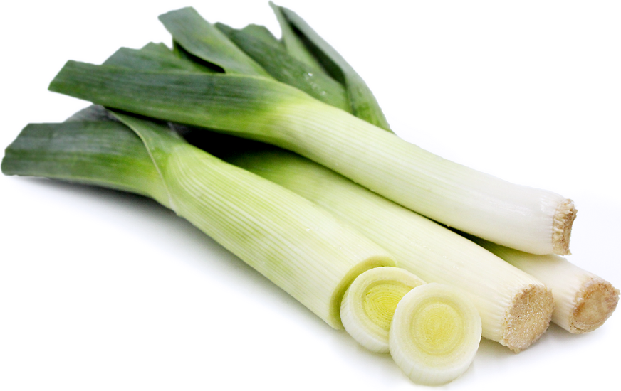
leeks
/l/
/ee/
/k/
/s/

Slide 16
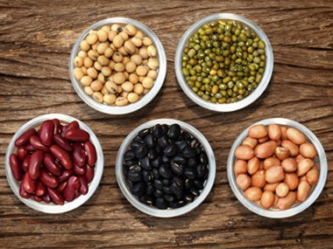
beans
/b/
/ee/
/n/
/z/

Slide 17
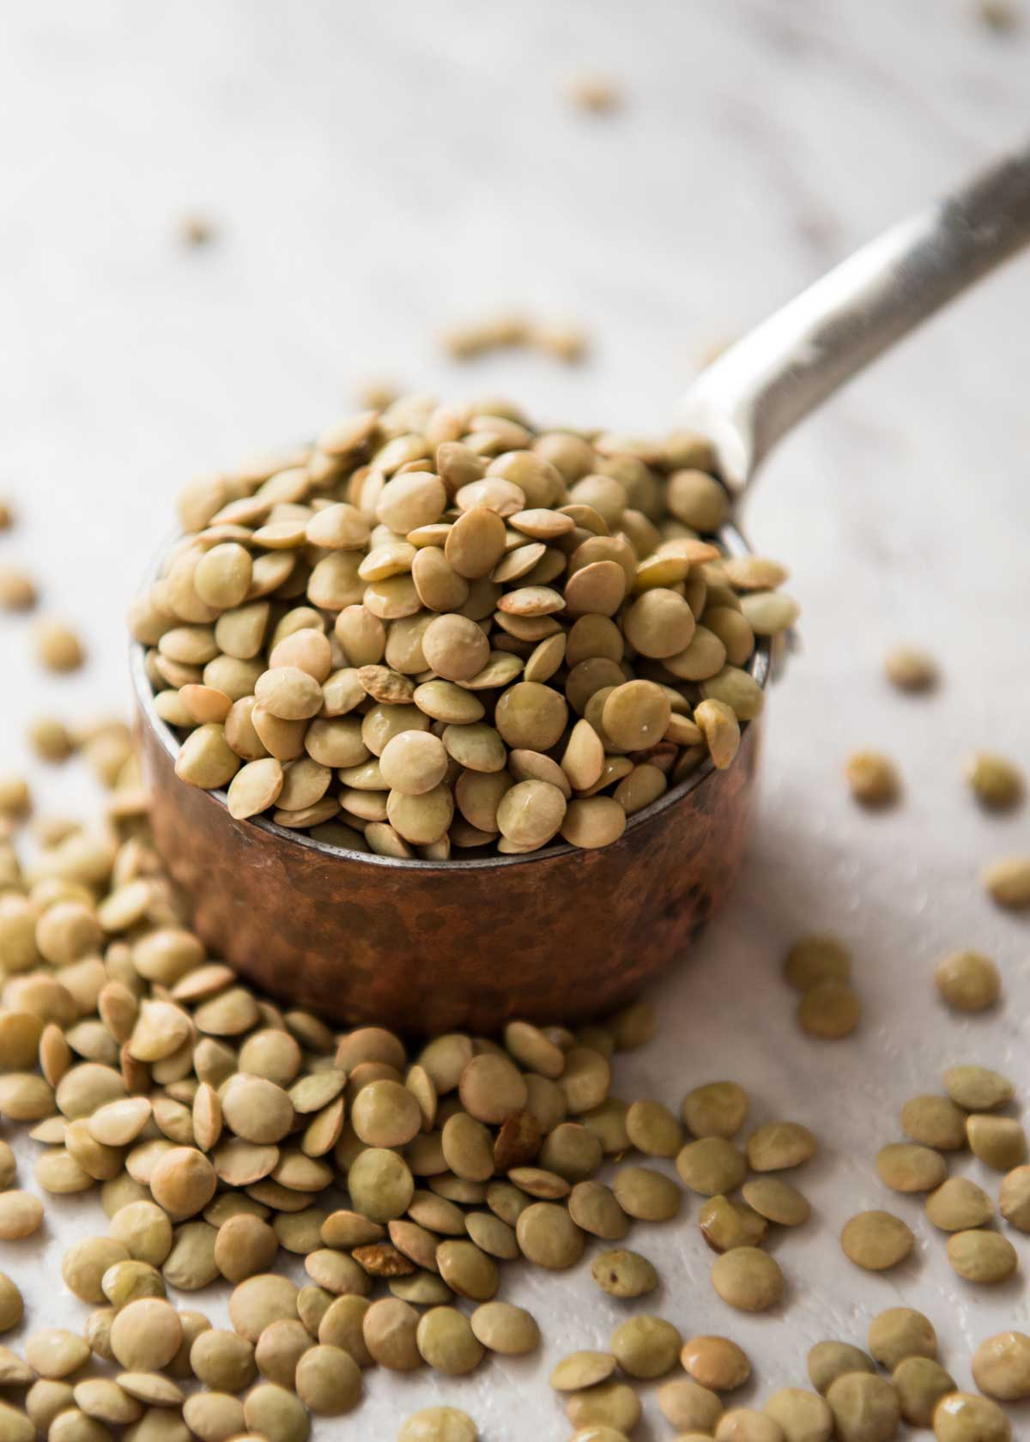
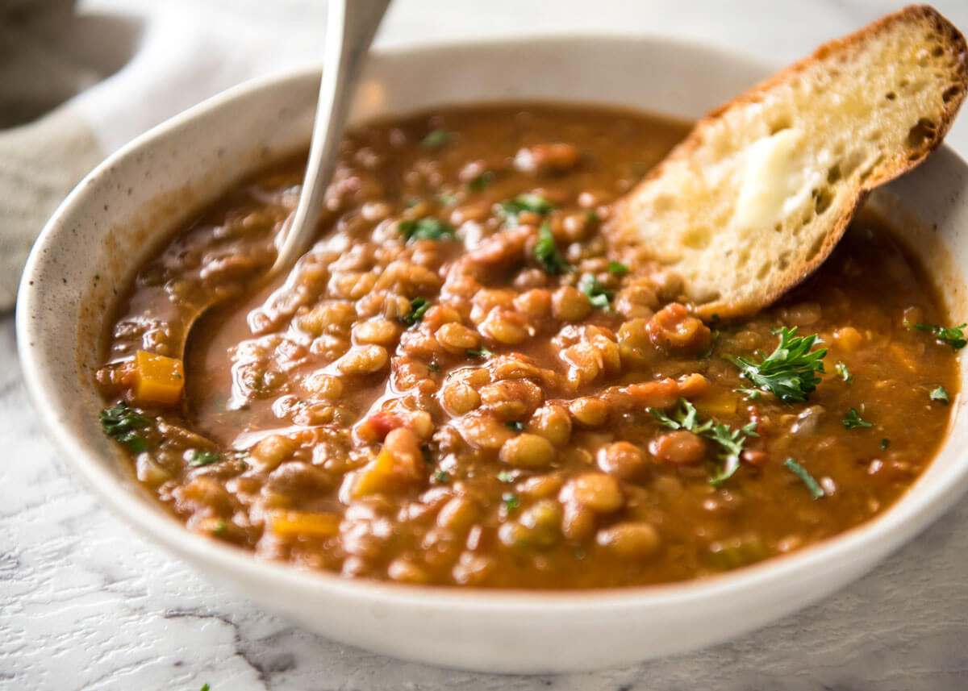
lentils
/l/
/e/
/n/
/t/
/i/
/l/
/z/

Slide 18
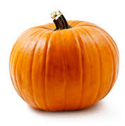
pumpkin
/p/
/u/
/m/
/p/
/k/
/i/
/n/

Slide 19
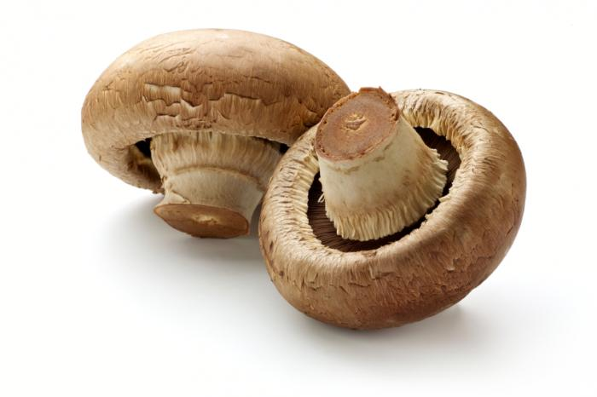
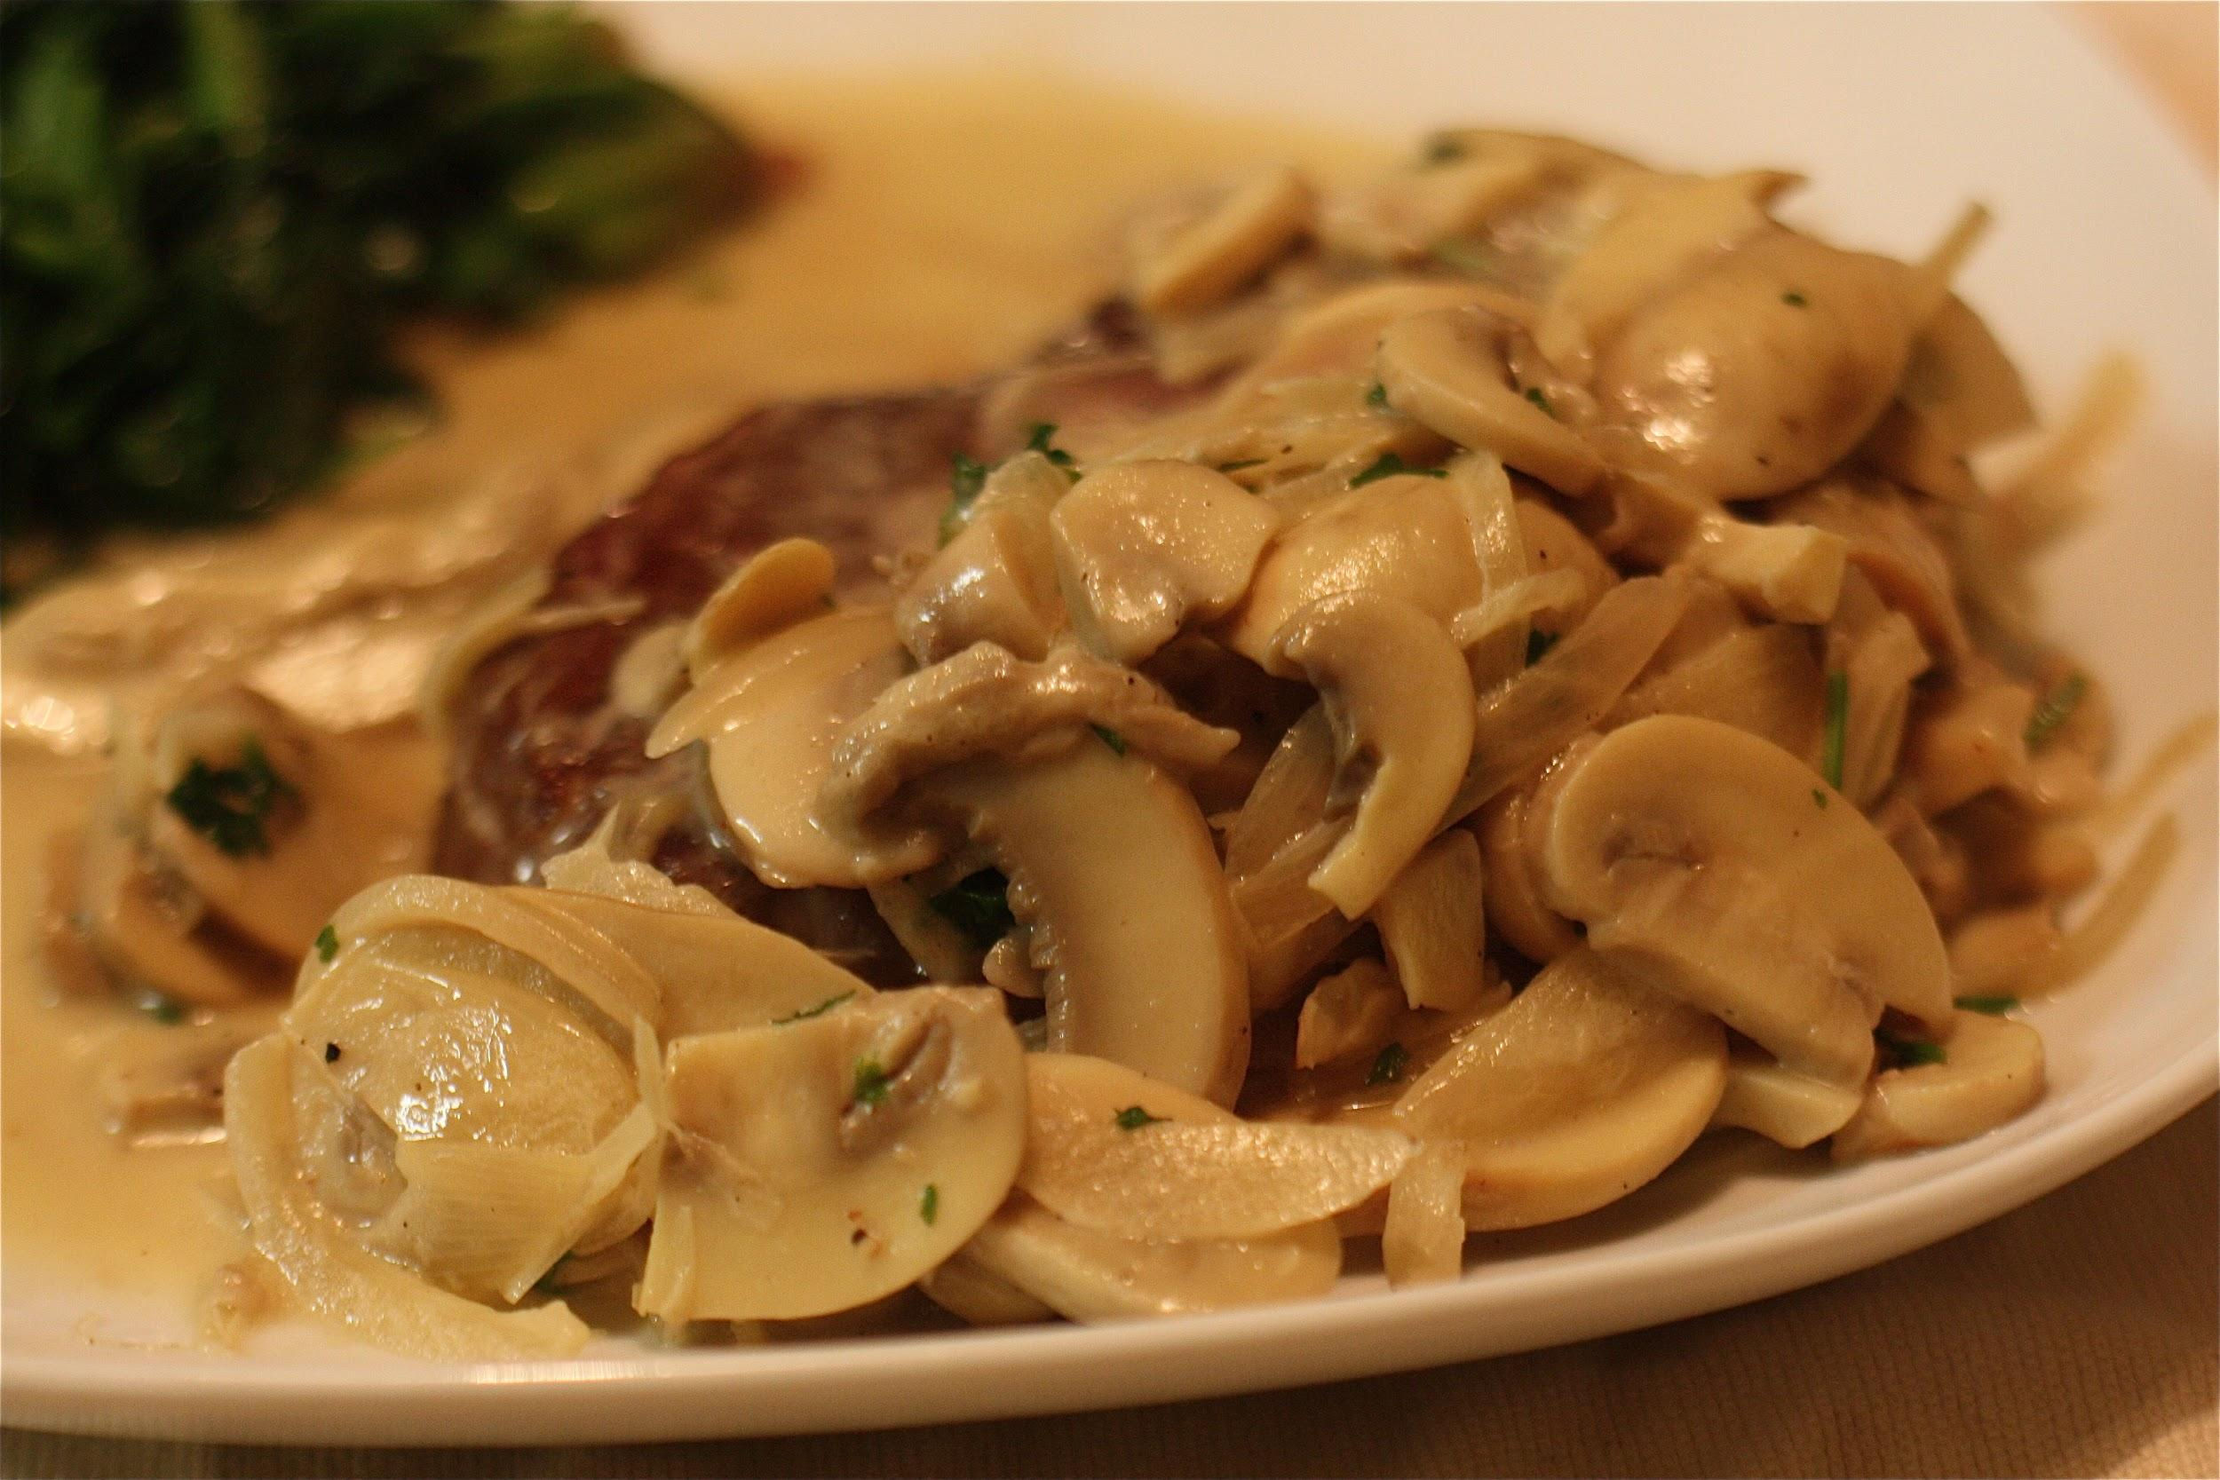
mushrooms
/m/
/u/
/sh/
/r/
/oo/
/m/
/z/

Slide 21
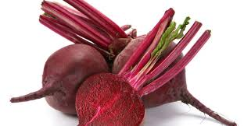
beetroot
/b/
/ee/
/t/
/r/
/oo/
/t/

Slide 22
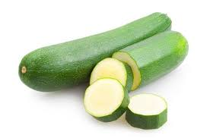

courgette

Slide 23
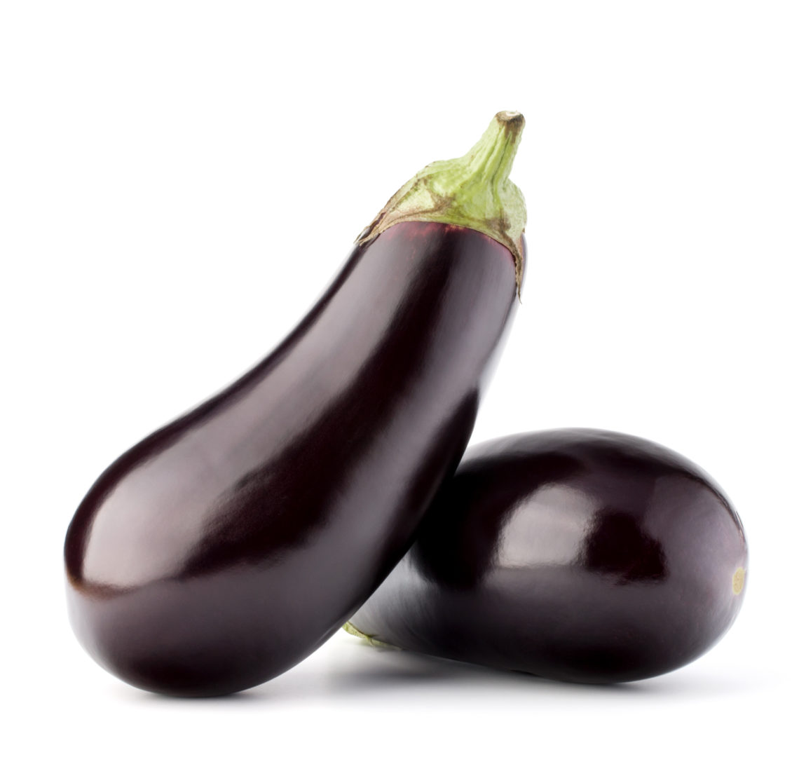
aubergine

